Slide 1
CLASSES AND OBJECTS

Slide 2
Class defines the shape and behavior of an object
Any concept we wish to represent is encapsulated in a class.
Java class includes instance variables and methods.
Class is a template for an object.
A Java program consists of one or more classes

Slide 3




A class is an abstract description of objects
class Car {
...description of a car goes here...
}
some objects of class:

Slide 4
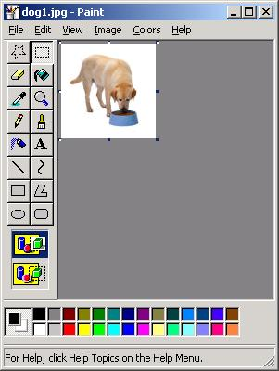
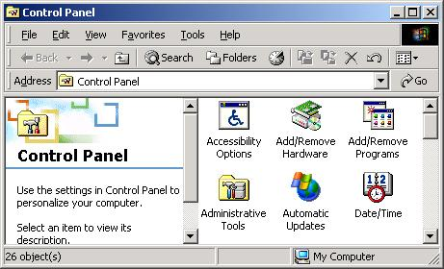
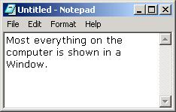
Here is another example of a class:
  class Window { ... }
Some examples of Windows:

Slide 5
Basic Terminology
A class defines a kind of objects:
  specifies the kinds of attributes (data) an object can have.
  provides methods specifying the actions an object can take.
An object is an instance of the class.
Person is a class
  Alice and Bob are objects of the Person class.

Slide 6
What does a class have?
Members of a class:
  Attributes (instance variables)
    For each instance of the class (object), values of attributes can vary.
  Methods
Person class
  Attributes: name, address, phone number
  Methods: change address, change phone number
Alice object
  Name is Alice, address is …
Bob object
  Name is Bob, address is …

Slide 7
class classname
{ type instance-variable1;
// ...
type instance-variableN;
type methodname1(parameter-list)
{ // body of method
}
// ...
type methodnameN(parameter-list)
{ // body of method
}
}

Slide 8
class Box
{
double width;
double height;
double depth;
}

Slide 9

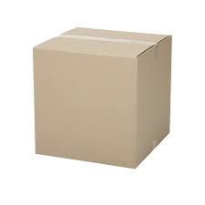
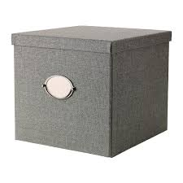
class Box
{
double width;
double height;
double depth;
}

Slide 10
Box mybox = new Box(); // create a Box object

Slide 11
mybox.width = 100;

Slide 12
class Box
{ double width;
double height;
double depth;
}
class BoxDemo
{ public static void main(String args[])
{ Box mybox = new Box();
double vol;
mybox.width = 10;
mybox.height = 20;
mybox.depth = 15;
vol = mybox.width * mybox.height * mybox.depth;
System.out.println("Volume is " + vol);
} }

Slide 13
class BoxDemo2
{ public static void main(String args[])
{ Box mybox1 = new Box();
Box mybox2 = new Box();
double vol;
mybox1.width = 10;
mybox1.height = 20;
mybox1.depth = 15;
mybox2.width = 3;
mybox2.height = 6;
mybox2.depth = 9;
vol = mybox1.width * mybox1.height * mybox1.depth;
System.out.println("Volume is " + vol);
vol = mybox2.width * mybox2.height * mybox2.depth;
System.out.println("Volume is " + vol);
} }

Slide 14
Declaring Objects
Box mybox = new Box();
This statement combines the two steps.
Box mybox; // declare reference to object
mybox = new Box(); // allocate a Box object

Slide 15
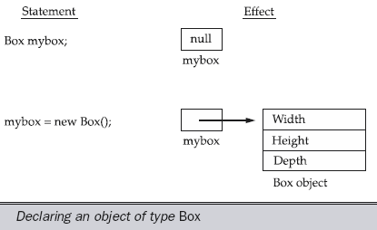

Slide 16
Assigning Object Reference Variables
Box b1 = new Box();
Box b2 = b1;

Slide 17
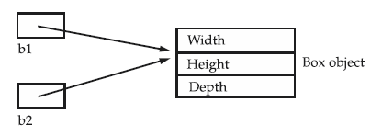

Slide 18
Box b1 = new Box();
Box b2 = b1;
// ...
b1 = null;
b1 has been set to null, but b2 still points to the original object.

Slide 19
Introducing Methods
type name(parameter-list)
{
// body of method
}

Slide 20
Adding a Method to the Box Class
class Box
{
double width;
double height;
double depth;
void volume()
{ System.out.print("Volume is ");
System.out.println(width * height * depth);
}
}

Slide 21
class BoxDemo3
{ public static void main(String args[])
{ Box mybox1 = new Box();
Box mybox2 = new Box();
mybox1.width = 10;
mybox1.height = 20;
mybox1.depth = 15;
mybox2.width = 3;
mybox2.height = 6;
mybox2.depth = 9;
mybox1.volume();
mybox2.volume();
} }

Slide 22
Returning value
class Box
{
double width;
double height;
double depth;
double volume()
{
return width * height * depth;
}
}

Slide 23
class BoxDemo4
{ public static void main(String args[])
{ Box mybox1 = new Box();
Box mybox2 = new Box();
double vol;
mybox1.width = 10; mybox1.height = 20; mybox1.depth = 15;
mybox2.width = 3; mybox2.height = 6; mybox2.depth = 9;
vol = mybox1.volume();
System.out.println("Volume is " + vol);
vol = mybox2.volume();
System.out.println("Volume is " + vol);
} }

Slide 24
// parameterized method.
class Box
{ double width; double height; double depth;
double volume()
{ return width * height * depth; }
void setDim(double w, double h, double d)
{
width = w;
height = h;
depth = d;
}
}

Slide 25
class BoxDemo5
{ public static void main(String args[])
{
Box mybox1 = new Box();
Box mybox2 = new Box();
double vol;
mybox1.setDim(10, 20, 15);
mybox2.setDim(3, 6, 9);
vol = mybox1.volume();
System.out.println("Volume is " + vol);
vol = mybox2.volume();
System.out.println("Volume is " + vol);
}
}

Slide 26
class Rect
{
int length, width,area;
void setData(int l,int w)
{
length = l;
width = w;
}
int computeArea()
{
area = length * width;
return area;
}
void disp()
{
System.out.println("area "+area);
}
}

Slide 27
class prg6
{
public static void main(String args[])
{
Rect r1 = new Rect();
Rect r2 = new Rect();
r1.setData(5,6);
r2.setData(8,9);
int res1 = r1.computeArea();
int res2 = r2.computeArea();
System.out.println("area "+res1);
System.out.println("area "+res2);
}
}

Slide 28
Constructor

Slide 29
Constructor
Constructor is a special type of method.
Constructor has the same name as the class name.
Constructor cannot return values.
Constructor is normally used for initializing objects.
gets invoked “automatically” at the time of object creation.
A class can have more than one constructor.

Slide 30
class Box
{
double width; double height; double depth;
Box()
{
System.out.println("Constructing Box");
width = 10; height = 20; depth = 30;
}
double volume()
{ return width * height * depth; }
}

Slide 31
class BoxDemo6
{ public static void main(String args[])
{
Box mybox1 = new Box();
Box mybox2 = new Box();
double vol;
vol = mybox1.volume();
System.out.println("Volume is " + vol);
vol = mybox2.volume();
System.out.println("Volume is " + vol);
}
}

Slide 32
Parameterized Constructors

Slide 33
class Box
{
double width; double height; double depth;
Box(double w, double h, double d)
{ width = w;
height = h;
depth = d;
}
double volume()
{ return width * height * depth; }
}

Slide 34
class BoxDemo7
{ public static void main(String args[])
{
Box mybox1 = new Box(10, 20, 15);
Box mybox2 = new Box(3, 6, 9);
double vol;
vol = mybox1.volume();
System.out.println("Volume is " + vol);
vol = mybox2.volume();
System.out.println("Volume is " + vol);
}
}

Slide 35
this keyword
Box(double w, double h, double d)
{
this.width = w;
this.height = h;
this.depth = d;
}

Slide 36
instance variable hiding
// to resolve name-space collisions.
Box(double width, double height, double depth)
{
this.width = width;
this.height = height;
this.depth = depth;
}

Slide 37
class Rect
{
int length, width,area;
void setData(int l,int w)
{
length = l;
width = w;
}
int computeArea()
{
area = length * width;
return area;
}
void disp()
{
System.out.println("area "+area);
}
}

Slide 38
class prg6
{
public static void main(String args[])
{
Rect r1 = new Rect();
Rect r2 = new Rect();
r1.setData(5,6);
r2.setData(8,9);
int res1 = r1.computeArea();
int res2 = r2.computeArea();
System.out.println("area "+res1);
System.out.println("area "+res2);
}
}

Slide 39
class Rect
{
int length, width,area;
Rect(int l,int w)
{
length = l;
width = w;
}
int computeArea()
{
area = length * width;
return area;
}
void disp()
{
System.out.println("area "+area);
}
}

Slide 40
class prg6
{
public static void main(String args[])
{
Rect r1 = new Rect(5,6);
Rect r2 = new Rect(8,9);
// r1.setData(5,6);
// r2.setData(8,9);
int res1 = r1.computeArea();
int res2 = r2.computeArea();
System.out.println("area "+res1);
System.out.println("area "+res2);
}
}

Slide 41
A stack class

Slide 42
// This class defines an integer stack that can hold 10 values.
class Stack
{ int stck[] = new int[10];
int tos;
Stack()
{ tos = -1;
}
void push(int item)
{
if(tos==9)
System.out.println("Stack is full.");
else
stck[++tos] = item;
}

Slide 43
// Pop an item from the stack
int pop()
{
if(tos < 0)
{
System.out.println("Stack underflow.");
return 0;
}
else
return stck[tos--];
}
}

Slide 44
class TestStack
{ public static void main(String args[])
{
Stack mystack1 = new Stack();
Stack mystack2 = new Stack();
for(int i=0; i<10; i++)
mystack1.push( i );
for(int i=10; i<20; i++)
mystack2.push( i );
System.out.println("Stack in mystack1:");
for(int i=0; i<10; i++)
System.out.println(mystack1.pop());
System.out.println("Stack in mystack2:");
for(int i=0; i<10; i++)
System.out.println(mystack2.pop());
}
}

Slide 45
Stack in mystack1:
9
8
7
6
5
4
3
2
1
0
Stack in mystack2:
19
18
17
16
15
14
13
12
11
10
.

Slide 46
OVERLOADING METHODS

Slide 47
class OverloadDemo
{
void test()
{ System.out.println("No parameters");
}
void test(int a)
{ System.out.println("a: " + a);
}
void test(int a, int b)
{ System.out.println("a and b: " + a + " " + b);
}
double test(double a)
{ System.out.println("double a: " + a);
return a*a;
}
}

Slide 48
class Overload
{ public static void main(String args[])
{
OverloadDemo ob = new OverloadDemo();
double result;
ob.test();
ob.test(10);
ob.test(10, 20);
result = ob.test(123.25);
System.out.println("Result of ob.test(123.25): " + result);
}
}

Slide 49
// Automatic type conversions apply to overloading.
class OverloadDemo
{ void test()
{ System.out.println("No parameters");
}
void test(int a, int b)
{ System.out.println("a and b: " + a + " " + b);
}
void test(double a)
{ System.out.println("Inside test(double) a: " + a);
}
}

Slide 50
class Overload
{ public static void main(String args[])
{
OverloadDemo ob = new OverloadDemo();
int i = 88;
ob.test();
ob.test(10, 20);
ob.test(i); // this will invoke test(double)
ob.test(123.2); // this will invoke test(double)
}}

Slide 51
OVERLOADING CONSTRUCTORS

Slide 52
class Box
{ double width; double height; double depth;
Box(double w, double h, double d)
{ width = w; height = h; depth = d; }
Box()
{ width = -1; // use -1 to indicate
height = -1; // an uninitialized
depth = -1; // box }
Box(double len)
{ width = height = depth = len; }
double volume()
{ return width * height * depth; } }

Slide 53
class OverloadCons
{ public static void main(String args[])
{
Box mybox1 = new Box(10, 20, 15);
Box mybox2 = new Box();
Box mycube = new Box(7);
double vol;
vol = mybox1.volume();
System.out.println("Volume of mybox1 is " + vol);
vol = mybox2.volume();
System.out.println("Volume of mybox2 is " + vol);
vol = mycube.volume();
System.out.println("Volume of mycube is " + vol); }}

Slide 54
Using object as a parameter

Slide 55
class Test
{ int a, b;
Test(int i, int j)
{ a = i;
b = j; }
boolean equals( Test o )
{
if(o.a == a && o.b == b) return true;
else return false;
}
}

Slide 56
class PassOb
{
public static void main(String args[])
{
Test ob1 = new Test(100, 22);
Test ob2 = new Test(100, 22);
Test ob3 = new Test(-1, -1);
System.out.println("ob1 == ob2: " + ob1.equals(ob2));
System.out.println("ob1 == ob3: " + ob1.equals(ob3));
}
}

Slide 57
// Here, Box allows one object to initialize another.
class Box
{ double width; double height; double depth;
// construct clone of an object
Box(Box ob)
{ width = ob.width;
height = ob.height;
depth = ob.depth;
}
Box(double w, double h, double d)
{ width = w;
height = h;
depth = d; }

Slide 58
Box()
{ width = -1;
height = -1;
depth = -1;
}
// constructor used when cube is created
Box(double len)
{ width = height = depth = len;
}
double volume()
{ return width * height * depth;
}
}

Slide 59
class OverloadCons2
{ public static void main(String args[])
{
Box mybox1 = new Box(10, 20, 15);
Box mybox2 = new Box();
Box mycube = new Box(7);
Box myclone = new Box(mybox1);
double vol;
vol = mybox1.volume();
System.out.println("Volume of mybox1 is " + vol);
}
}

Slide 60
Argument Passing
// Simple types are passed by value.
class Test
{ void meth(int a)
{ a = a+10;
}
}
class CallByValue
{ public static void main(String args[])
{ Test ob = new Test();
int a = 15;
System.out.println(“value of a before call: " + a );
ob.meth(a);
System.out.println(“value of a after call " +a); } }

Slide 61
// Objects are passed by reference.
class Test
{ int a, b;
Test(int i, int j)
{ a = i;
b = j;
}
// pass an object
void meth(Test o)
{
o.a = o.a+ 10;
o.b = 0.b - 10;
}
}

Slide 62
class CallByRef
{
public static void main(String args[])
{
Test ob = new Test(15, 20);
System.out.println("ob.a and ob.b before call: " +ob.a + " " + ob.b);
ob.meth(ob);
System.out.println("ob.a and ob.b after call: " +ob.a + " " + ob.b);
}
}

Slide 63
Returning objects
// Returning an object.
class Test
{ int a;
Test(int i)
{ a = i;
}
Test incrByTen()
{
Test temp = new Test(a+10);
return temp;
}
}

Slide 64
class RetOb
{ public static void main(String args[])
{
Test ob1 = new Test(2);
Test ob2;
ob2 = ob1.incrByTen();
System.out.println("ob1.a: " + ob1.a);
System.out.println("ob2.a: " + ob2.a);
ob2 = ob2.incrByTen();
System.out.println("ob2.a after second increase: “+ ob2.a);
}
}

Slide 65
ob1.a: 2
ob2.a: 12
ob2.a after second increase: 22

